Slide 1
Engagement Substitution on Social Forums: The Case of Meme Stocks and Reddit
November 6, 2023
KS Economic Research Team

Slide 2



Community size in a social network is mainly tied to the extensive margin of value creation; Engagement is often triggered by interest waves
The economics literature tells us that several factors (e.g., network effects, quality, multi-homing costs) affect the growth of platforms: e.g., (Zhu and Iansiti, 2012), Lee (2013)³
Platforms with more contributors have more productive volunteer communities (Loh and Kretschmer, 2022)¹ - this relationship is mainly driven by the extensive margin
Social networks attract audiences that can be monetized via advertising – the intensive margin, engagement, is key
The relative importance of community size is shown by adoption models in the literature³
Platform penetration rate
100%
75%
50%
25%
0%
2011
2012
2013
2014
2015
2016
2017
2018
Engagement seems less strongly tied to community size; trigger events can reveal key patterns
Value on digital platforms (e.g., Reddit) often created by communities of volunteers (e.g., Fershtman & Gandal, 2011; Lakhani & Wolf, 2005; Lerner & Tirole, 2002)
Engagement in those communities can be an isolated phenomenon (Buntain & Golbeck, 2014)²
However, a trigger event (Pang, 2013) can unveil spill-overs in engagement across communities (e.g., Subreddits) and the dynamics of engagement
1.8
1.6
Total comments
1.4
Comments on shocked Subreddit
1.2
Mean comments on all other Subreddits
1.0
Number of comments per day
0.8
0.6
0.4
0.2
0.0
Sep 2020
Nov 2020
Jan 2021
Mar 2021
May 2021
Jul 2021
³ Robin Lee, “Vertical Integration and Exclusivity in Platform and Two-Sided Markets”, 2013
⁴ KS Economic Research, “Platform Quality, Network Effects, and the Growth of Social Networks”, 2022
Notes:
Speaker: Vitoria

Slide 3


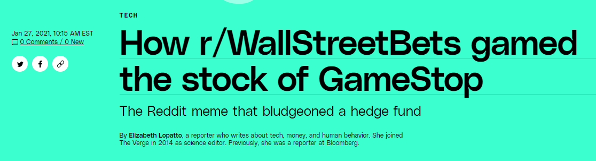
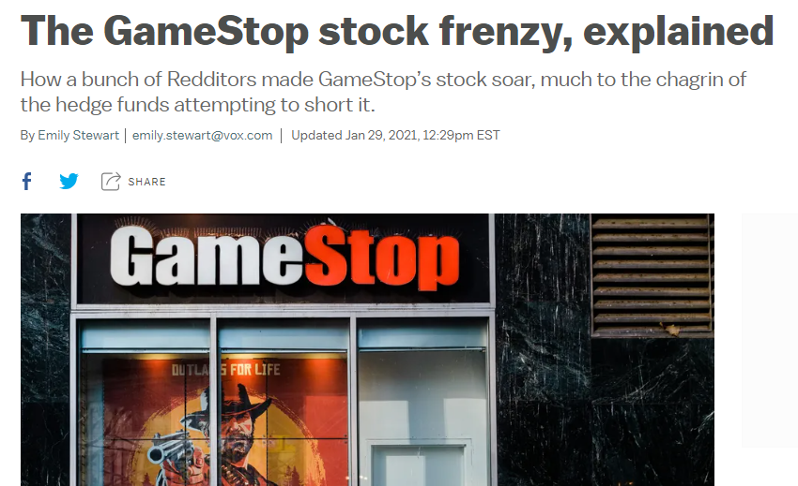


The GameStop short-squeeze was attributed to WSB users which triggered increased outsider attention for WSB
Unprecedented growth of meme stocks in Jan. 2021
Stock price of GME and AMC from 2020 to 2022
Google Trends interest over time for r/WSB
Massive spike starting the week of January 25, 2021
$90
100%
WSJ
$80
r/wallstreetbets
$70
80%
$60
$50
60%
Stock price
Google Trends interest over time
$40
40%
$30
$20
20%
$10
$0
0%
Jan 2020
Jul 2020
Jan 2021
Jul 2021
Jan 2022
Jul 2022
Jan 2023
Jul 2020
Oct 2020
Jan 2021
Apr 2021
Jul 2021
Oct 2021
Leverage the r/WSB trigger event to evaluate engagement changes across subreddits (spillover effects):
1. What do trigger events/attention shocks tell us about substitution and complementarity in social engagement?
2. Can a trigger event to a subreddit drive adoption and retention of news users?
Notes:
Speaker: Michael

Slide 4
The meme stock mania drove unprecedented engagement on Reddit
r/wallstreetbets holds the record for most engagement
Ranking of comments on a Subreddit in a single day
Largest number of users joining Reddit in a day
r/wallstreetbets likely drove new users to the platform
1.8M
r/wallstreetbets
125K
112K
r/wallstreetbets first time commenters
r/politics
r/FreeKarma4U
Total Reddit first-time commenters
1.5M
r/wallstreetbets
r/UFC237LiveStreams
r/WarriorsBlazers
r/politics
100K
1.2M
75K
Number of Subreddit comments in a single day
Number of Reddit users with a first-time comment
0.9M
#1
50K
0.6M
#2
35K
#3
#4
#5
#6
#7
#8
#9
#10
25K
0.3M
0.0M
Jan. 28, 2021
Jan. 27, 2021
Jan. 29, 2021
Feb. 1, 2021
Nov. 4, 2020
Feb. 2, 2021
May. 2, 2021
May. 14, 2019
May. 6, 2019
Nov. 6, 2020
0K
Jan 10, 2021
Jan 17, 2021
Jan 24, 2021
Jan 31, 2021
Feb 7, 2021
Notes:
Speaker: Michael

Slide 5
We can observe two sets of existing Reddit users of interest based on when they commented on r/WSB and other Subreddits
Group A: Pre-shock r/wallstreetbets commenters
Group B: Post-shock r/wallstreetbets commenters
Two conditions:
Pre-shock other subreddit comments: the user must have commented on any subreddit other than r/wallstreetbets in the 6 months prior to the shock
Pre-shock r/wallstreetbets comments: the user must have commented on r/wallstreetbets in the 6 months prior to the shock
Two conditions:
Pre-shock other subreddit comments: the user must have commented on any Subreddit other than r/wallstreetbets in the 6 months prior to the shock
Post-shock r/wallstreetbets comments: the user must have commented on r/wallstreetbets in the 6 months after to the shock
User commented on other subreddit in 6 mo. prior to the shock
User commented on other subreddit in 6 mo. prior to the shock
Other subreddit
Other subreddit
r/wallstreetbets
r/wallstreetbets
User commented on r/wallstreetbets in 6 mo. prior to the shock
User commented on r/wallstreetbets in 6 mo. prior to the shock
Pre-shock
Post-shock
Pre-shock
Post-shock

Slide 6
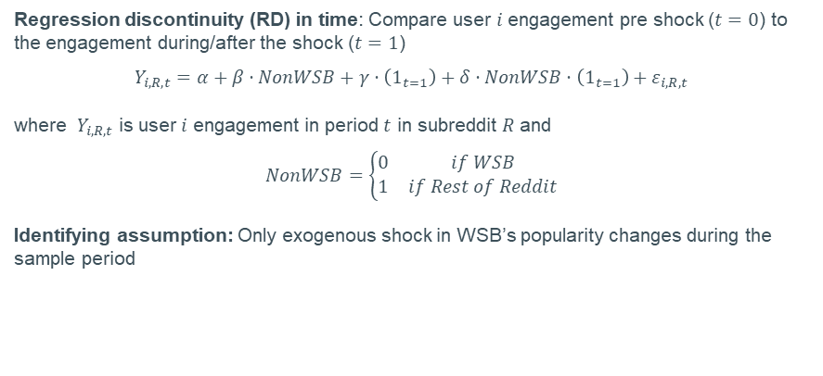
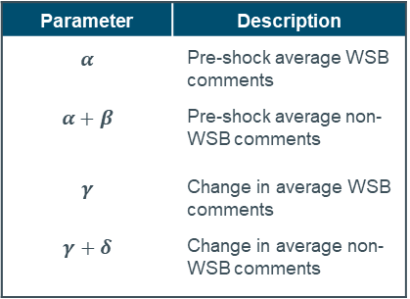








Capturing expected engagement and complementarity/substitutability
Regression discontinuity (RD) in time: Compare user $i$ engagement pre shock ($t=0$) to the engagement during/after the shock ($t=1$)
$$Y_{i,R,t}=α+β⋅NonWSB+γ⋅\left(1_{t=1}\right)+δ⋅NonWSB⋅\left(1_{t=1}\right)+ε_{i,R,t}$$
where $Y_{i,R,t}$ is user $i$ engagement in period $t$ in subreddit $R$ and
$$NonWSB=\left\{\begin{matrix}0 & if WSB \\ 1 & if Rest of Reddit\end{matrix}\right.$$
Identifying assumption: Only exogenous shock in WSB’s popularity changes during the sample period
Parameter | Description
$$α$$ | Pre-shock average WSB comments
$$α+β$$ | Pre-shock average non-WSB comments
$$γ$$ | Change in average WSB comments
$$γ+δ$$ | Change in average non-WSB comments
Expected user engagement
WSB ($NonWSB=0$)
Rest of Reddit ($NonWSB=1$)
Pre shock ($t=0$)
$$α$$
$$α+β$$
Post shock ($t=1$)
$$α+γ$$
Change in WSB engagement post-shock
$$α+β+γ+δ$$
Change in non-WSB engagement post-shock
Notes:
Speaker: Vangelis

Slide 7
The pooled results show that the shock on r/wallstreetbets was largely transient: engagement increased rapidly but died down quickly after
Weekly mean comments among pooled sample
Increased effect of engagement during the shocked period was transient
Three takeaways
1
1.8
Increased engagement during shock
Mean comments on r/wallstreetbets
2
1.6
Mean comments on all other Subreddits
No evidence of substitution or complementarity in other subreddits during the shocked period
Mean total comments
1.4
3
Transient effect of the shock with return back to pre-shock levels
1.2
1.0
Mean number of comments per user per day
0.8
1
2
0.6
3
0.4
0.2
0.0
Jul 2020
Sep 2020
Nov 2020
Jan 2021
Mar 2021
May 2021
Jul 2021
Sep 2021

Slide 8
Although an interesting pattern emerges when splitting users by their pre-shock levels of engagement…
Quartile #1: Significant increase in engagement post-shock
Least-engaged pre-shock users
Quartile #2: Increase and complementary engagement
Less engaged pre-shock users
0.7
Pre & post-shock means
Pre-shock: 0.026
Post-shock: 0.245
0.7
Pre & post-shock means
Pre-shock: 0.137
Post-shock: 0.344
0.6
0.6
0.5
0.5
0.4
0.4
Mean number of comments per day
0.3
0.3
0.2
0.2
0.1
0.1
0.0
0.0
Jul 2020
Sep 2020
Nov 2020
Jan 2021
Mar 2021
May 2021
Jul 2021
Sep 2021
Jul 2020
Sep 2020
Nov 2020
Jan 2021
Mar 2021
May 2021
Jul 2021
Sep 2021
Quartile #3: Complemented engagement during shock
Engaged pre-shock users
Quartile #4: Substitution of engagement during shock
Most engaged pre-shock users
1.2
Pre & post-shock means
Pre-shock: 0.493
Post-shock: 0.665
5
1.0
4
0.8
3
Mean number of comments per day
0.6
0.4
2
Pre & post-shock means
Pre-shock: 3.544
Post-shock: 3.030
0.2
1
0.0
0
Jul 2020
Sep 2020
Nov 2020
Jan 2021
Mar 2021
May 2021
Jul 2021
Sep 2021
Jul 2020
Sep 2020
Nov 2020
Jan 2021
Mar 2021
May 2021
Jul 2021
Sep 2021
Mean comments on r/wallstreetbets
Mean comments on all other subreddits
Mean total comments

Slide 9
Low engagement users seemed to get a wake-up call and started engaging nearly 10x more with Reddit following the shock
Quartile #1 of pre-shock engagement
Complementary effect of the shock on other subreddit engagement
Low engaged users engaged much more
1
0.40
Complementarity during the shocked period
Mean comments on r/wallstreetbets
2
0.35
Mean comments on all other subreddits
Significantly increased post-shock engagement
Mean total comments
0.25
post-shock mean total comments
0.30
1
0.25
Mean number of comments per day
0.20
0.15
2
0.10
0.026
pre-shock mean total comments
0.05
0.00
Jul 2020
Sep 2020
Nov 2020
Jan 2021
Mar 2021
May 2021
Jul 2021
Sep 2021

Slide 10
However, the opposite was true for the engaged users who substituted during the shock and engaged less following the shock
Quartile #4 of pre-shock engagement of pre-shock commenters
Substituted engagement during the shocked period away from other subreddits
4.5
Mean comments on r/wallstreetbets
3.54
pre-shock mean total comments
Mean comments on all other subreddits
4.0
Mean total comments
3.03
post-shock mean total comments
3.5
3.0
2.5
Mean number of comments per day
2.0
Seem to substitute comments during shock period
1.5
1.0
0.5
0.0
Jul 2020
Sep 2020
Nov 2020
Jan 2021
Mar 2021
May 2021
Jul 2021
Sep 2021
Notes:
Is the difference in pre and post equilibrium statistically significant? Yes.

Slide 11
So far we’ve looked at a broad group of users – what happens if we look at pre-existing r/wallstreetbets users v. new r/wallstreetbets users?
Group A: Pre-shock r/wallstreetbets commenters
Group B: Post-shock r/wallstreetbets commenters
Two conditions:
Pre-shock other subreddit comments: the user must have commented on any subreddit other than r/wallstreetbets in the 6 months prior to the shock
Pre-shock r/wallstreetbets comments: the user must have commented on r/wallstreetbets in the 6 months prior to the shock
Two conditions:
Pre-shock other subreddit comments: the user must have commented on any Subreddit other than r/wallstreetbets in the 6 months prior to the shock
Post-shock r/wallstreetbets comments: the user must have commented on r/wallstreetbets in the 6 months after to the shock
User commented on other subreddit in 6 mo. prior to the shock
User commented on other subreddit in 6 mo. prior to the shock
Other subreddit
Other subreddit
r/wallstreetbets
r/wallstreetbets
User commented on r/wallstreetbets in 6 mo. prior to the shock
User commented on r/wallstreetbets in 6 mo. prior to the shock
Pre-shock
Post-shock
Pre-shock
Post-shock

Slide 12
Comparison of Groups A and B (pre- and post-shock r/WSB commenters) shows only a few noticeable differences…
Group A: Pre-shock r/WSB commenters
Substitution during the shock with rapid decline post-shock
Group B: New r/WSB commenters post-shock
Seemingly flat during the shock with flatter post-shock
2.4
2.4
2.2
2.2
2.0
2.0
1.8
1.8
1.6
1.6
1.4
1.4
Mean number of comments per day
1.2
1.2
1.0
1.0
0.8
0.8
0.6
0.6
0.4
0.4
0.2
0.2
0.0
0.0
Jul 2020
Oct 2020
Jan 2021
Apr 2021
Jul 2021
Oct 2021
Jul 2020
Oct 2020
Jan 2021
Apr 2021
Jul 2021
Oct 2021
Mean comments on r/wallstreetbets
Mean comments on all other Subreddits
Mean total comments

Slide 13
…however, when splitting by engagement metrics, it’s clear there was a more pronounced effect on low engagement Group B commenters
Group A, Quartile #1: Pre-shock r/WSB commenters
Relatively lower increase in post-shock engagement
Group B, Quartile #1: Post-shock r/WSB commenters
Substantial increase in post-shock engagement
0.6
Pre & post-shock means
Pre-shock: 0.050
Post-shock: 0.141
0.6
Pre & post-shock means
Pre-shock: 0.018
Post-shock: 0.257
Level of post-shock engagement is higher for new users
0.5
0.5
0.4
0.4
Mean number of comments per day
0.3
0.3
0.2
0.2
0.1
0.1
0.0
0.0
Jul 2020
Sep 2020
Nov 2020
Jan 2021
Mar 2021
May 2021
Jul 2021
Sep 2021
Jul 2020
Sep 2020
Nov 2020
Jan 2021
Mar 2021
May 2021
Jul 2021
Sep 2021
Group A, Quartile #4: Pre-shock r/WSB commenters
Pronounced decreased in total comments
Group B, Quartile #4: Post-shock r/WSB commenters
More muted decrease of most engaged users
6
6
5
5
4
4
Mean number of comments per day
3
Pre & post-shock means
Pre-shock: 4.515
Post-shock: 4.215
3
2
2
Pre & post-shock means
Pre-shock: 3.032
Post-shock: 2.776
1
1
0
0
Jul 2020
Sep 2020
Nov 2020
Jan 2021
Mar 2021
May 2021
Jul 2021
Sep 2021
Jul 2020
Sep 2020
Nov 2020
Jan 2021
Mar 2021
May 2021
Jul 2021
Sep 2021
Mean comments on r/wallstreetbets
Mean comments on all other subreddits
Mean total comments

Slide 14
Additionally, when new users joined during the shock period, they continued to engage following the shock, at significant levels
Proportion of Reddit comments made by users who joined during the shock period over time
Users that joined during the shock stayed engaged in aggregate, making up >1% of all Reddit comments 6 months after the shock
12%
11.3%
Sample of users included: Any users that joined during the shock period
10%
8%
6%
2%
Mean proportion of comments on Reddit from this group
4%
2%
0%
Jul 2020
Sep 2020
Nov 2020
Jan 2021
Mar 2021
May 2021
Jul 2021
Sep 2021

Slide 15
Appendix

Slide 16

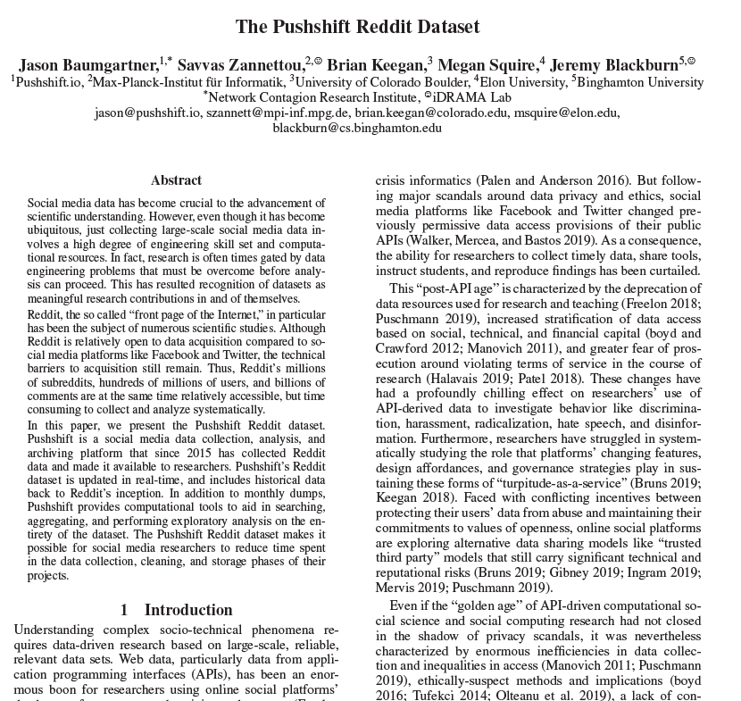

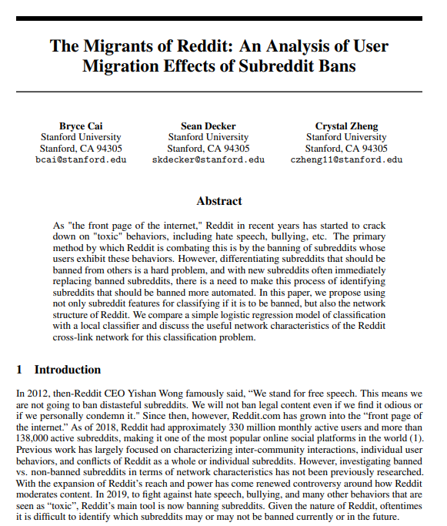
Data used for the analysis effectively cover the entire post and comment history of Reddit, from Pushshift.io
Pushshift.io archives all Reddit comment and post history
In terms of credibility, Pushshift has been used for numerous academic publications across disciplines
Submissions database
Comments database
All Reddit submissions
Includes core fields for analysis, such as
Author username
Created time
Subreddit
Title
Post text
Number of comments
Score (net upvotes and downvotes)
All Reddit comments
Includes core fields for analysis, such as
Author username
Created time
Subreddit
Comment text
Score (net upvotes and downvotes)
Main dataset used for analysis
Thanks to Data Shared Services, we have easy access to the entire Reddit archive!
See Pushshift.io and the Pushshift Reddit Dataset for details.
16
Notes:
SHOUT OUT TO AARON AND HIS BABY AND DATA TEAM
Speaker: Vangelis

Slide 17
To examine changes to user behavior over time, we examine three core periods, pre-shock, shock, and post-shock
Total Reddit comments over sample period
Spike of comments during the shocked period
Total r/wallstreetbets comments over sample
Major spike during the shocked period
50M
Pre-shock
6 months prior to the shock
Post-shock
6 months following the shock
6M
Pre-shock
6 months prior to the shock
Post-shock
6 months following the shock
48M
4M
46M
44M
2M
42M
40M
0M
Jul 2020
Sep 2020
Nov 2020
Jan 2021
Mar 2021
May 2021
Jul 2021
Sep 2021
Jul 2020
Sep 2020
Nov 2020
Jan 2021
Mar 2021
May 2021
Jul 2021
Sep 2021
Shock period
17
Notes:
Speaker: Vangelis

Slide 18
Regression results confirm our initial findings from the plots…

Slide 19
Specifically, less engaged users complemented their engagement on r/wallstreetbets with engagement on other subreddits during the shock
Complemented engagement on r/wallstreetbets with engagement on other subreddits

Slide 20
However, the most engaged users substituted their engagement during the shock
Substitution of engagement for the most engaged users pre-shock

Slide 21
Additionally, post-shock engagement is highly dependent on pre-shock levels of engagement…
Less engaged users increased their engagement significantly post-shock…

Slide 22
…with the most engaged users substituting their engagement
…while the most engaged users actually decreased their engagement post shock

